Slide 1

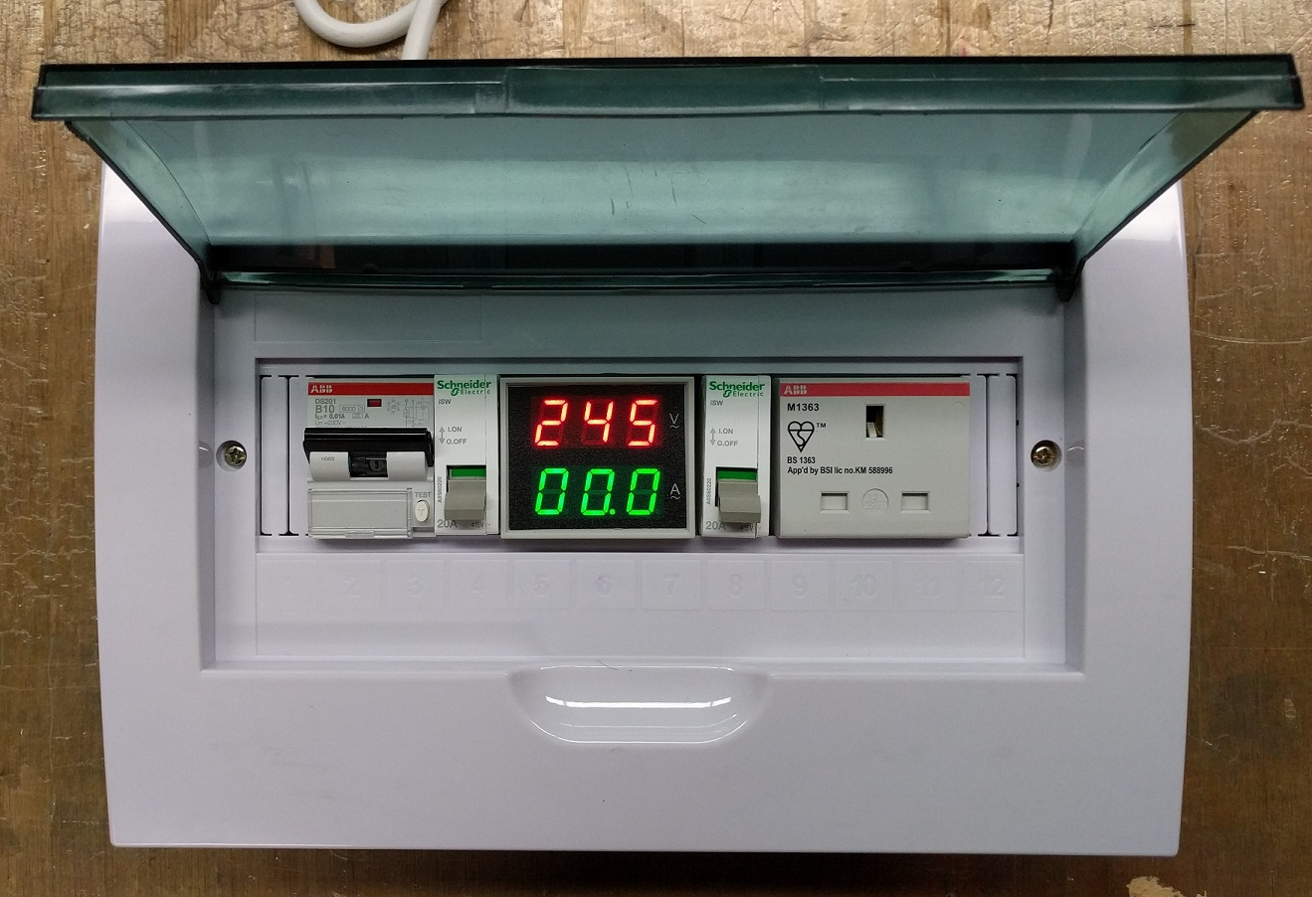
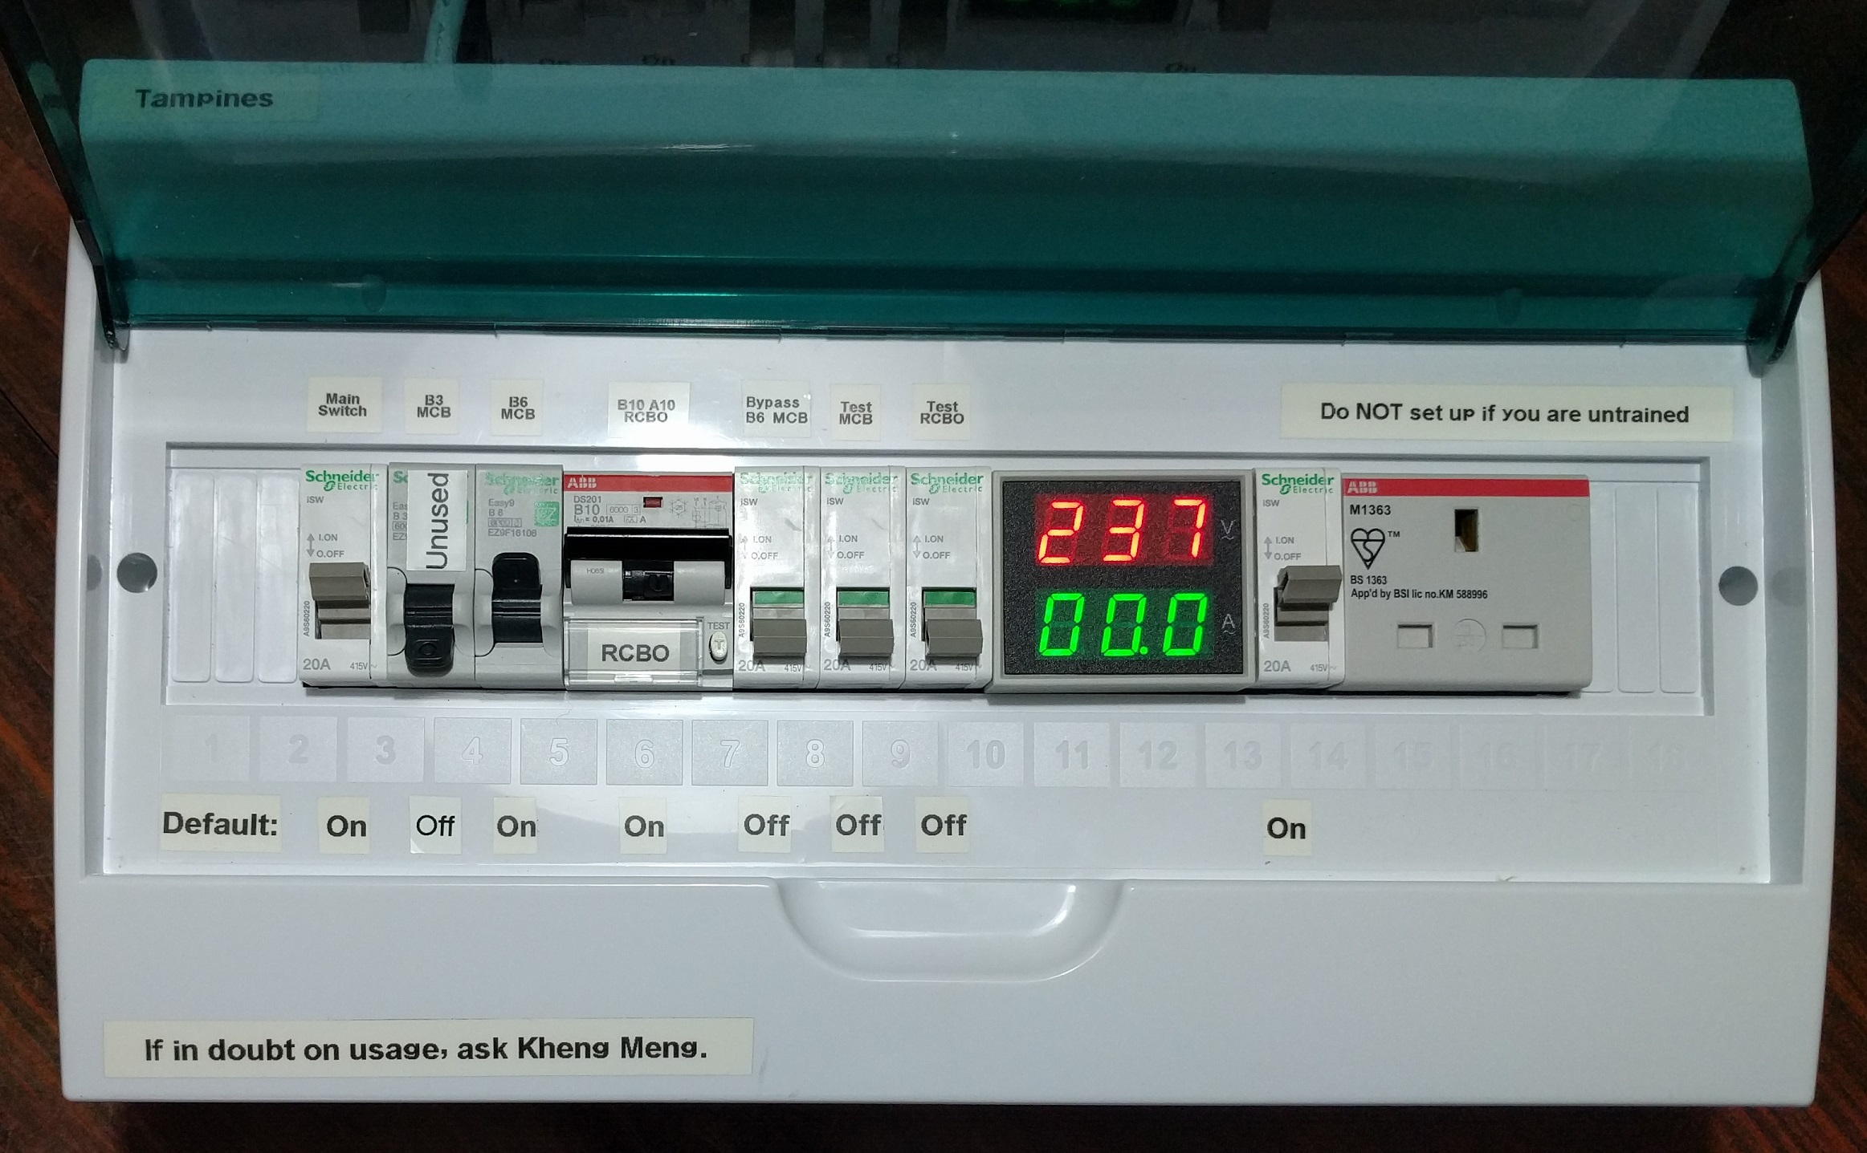
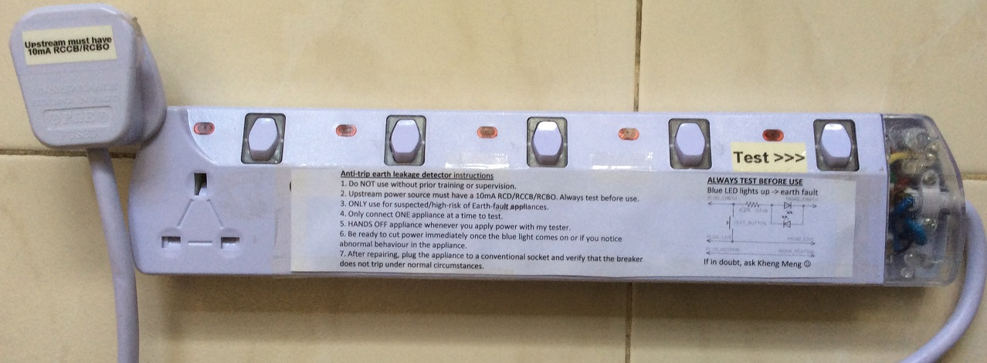
Repair Kopitiam Circuit Breaker Training
By: Yeo Kheng Meng (yeokm1@gmail.com)
https://github.com/yeokm1/repair-kopitiam-training-and-equipment
http://yeokhengmeng.com/2016/05/repair-kopitiam-speciality-electrical-tools/
For Repair Kopitiam Training

Slide 2
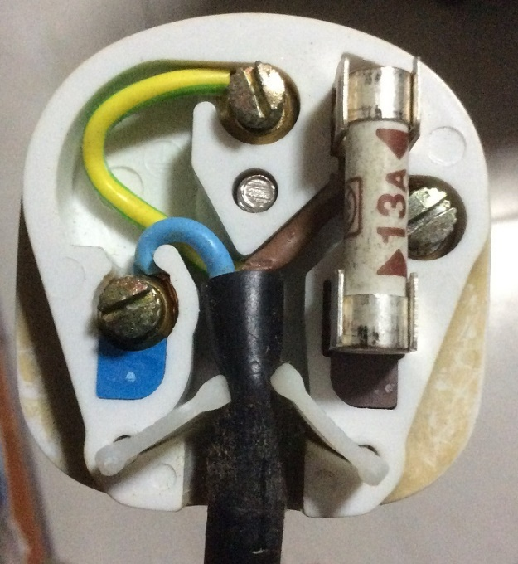
Inside the 3-pin mains plug (BS1363)
Earth
Yellow/Green
Connects to appliance’s external case, protects user from electric shock
Fuse
Blows on overcurrent
Usually 13A
Neutral
Blue/Black
Completes the circuit to generator
Tied to ground at power distribution box to ensure stable 0V
Live
Brown/Red
Source of power

Slide 3
Earth connections: Normal operation
Kettle
Mains Live
Fuse
230V
AC ~
Mains Neutral
Mains Earth
Earth

Slide 4
Live wire touches case
X
Kettle
Mains Live
Fuse
230V
AC ~
Mains Neutral
Mains Earth
Earth

Slide 5
What if there is no Earth wire?
Fuse does not blow due to human-body resistance
Kettle
Mains Live
Fuse
230V
AC ~
Mains Neutral
Earth

Slide 6
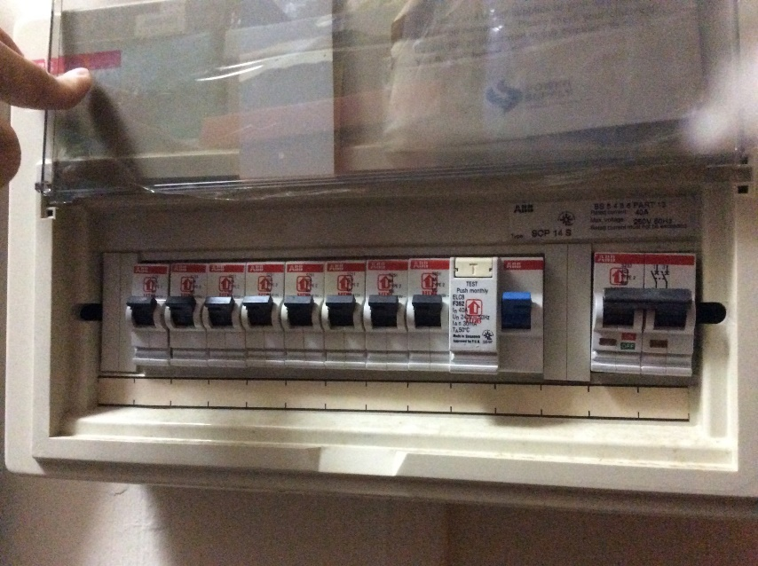
Circuit Breakers
MCB
RCCB
Miniature Circuit Breakers (MCBs)
What it does?
Breaks the circuit on overcurrent eg. short circuit
Residual Current Circuit Breaker (RCCB)
What it does? Breaks the circuit on earth fault
Cause: Current leakage via Earth wire or human electrocution
When?: Breaks when current difference between live neutral > threshold (usually 30mA)

Slide 7
Circuit breaker arrangement
Mains Live
Kettle
MCB
RCCB
Fuse
230V
AC ~
Mains Neutral
Mains Earth
Earth
Residual Current Circuit Breaker (RCCB)
What it does? Breaks the circuit on earth fault
Cause: Current leakage via Earth wire or human electrocution
When?: Breaks when current difference between live neutral > threshold (usually 30mA)
Miniature Circuit Breakers (MCBs)
What it does?
Breaks the circuit on overcurrent eg. short circuit

Slide 8
Residual Current Circuit Breaker with Overload Protection (RCBO)
Mains Live
Kettle
RCBO
Fuse
230V
AC ~
Mains Neutral
Mains Earth
Earth
RCBO = RCCB + MCB

Slide 9
Blackout recovery procedure
Why? Overcurrent or earth-leakage detected
Turn off every electrical device
Flip breaker to ON
Turn on ONE device at a time. If it trips again, you have found your spoilt device.
Prioritise simple devices like lamps/ovens.
Computers and refrigerators are sensitive to repeated power cycles.
Unplug that spoilt appliance
Flip breaker back on.

Slide 10
Problems
Safety
Inaccessible onsite breaker
Inconvenience of breaker trip

Slide 11
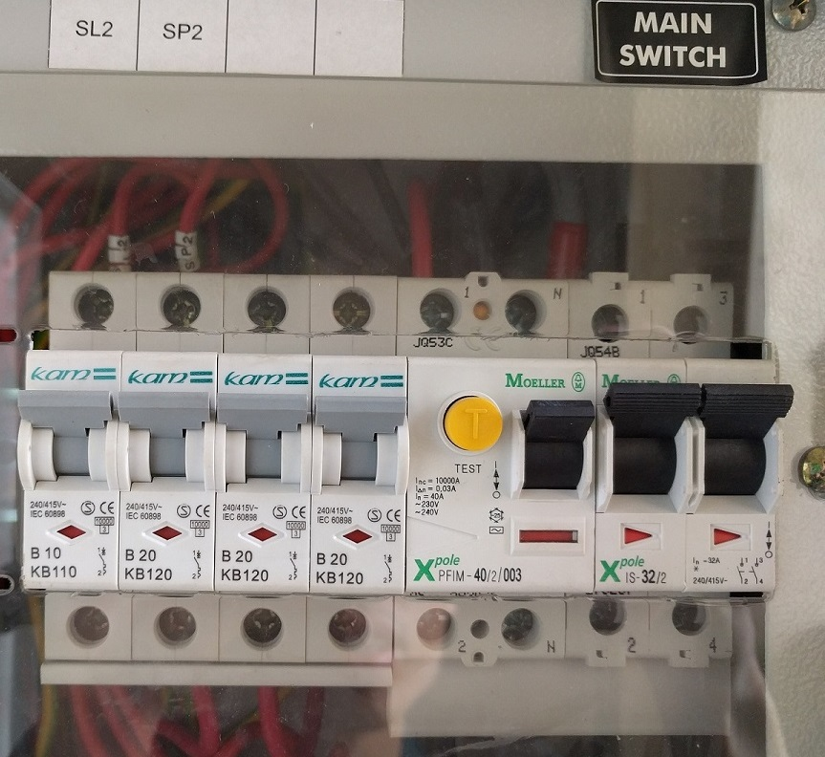
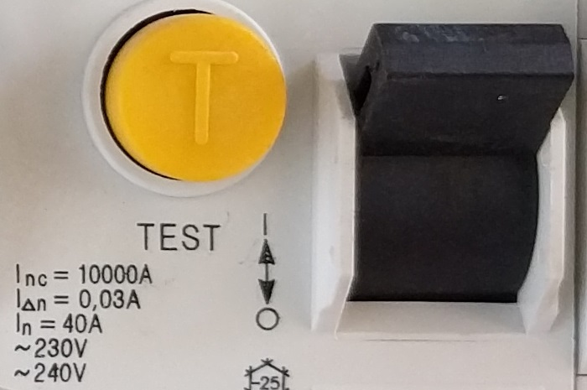
Problem 1: Safety
Typical I_{△n} = 30ma threshold for earth leakage
Balance between safety and nuisance trips
But RK always deals with high-risk faulty appliances…

Slide 12
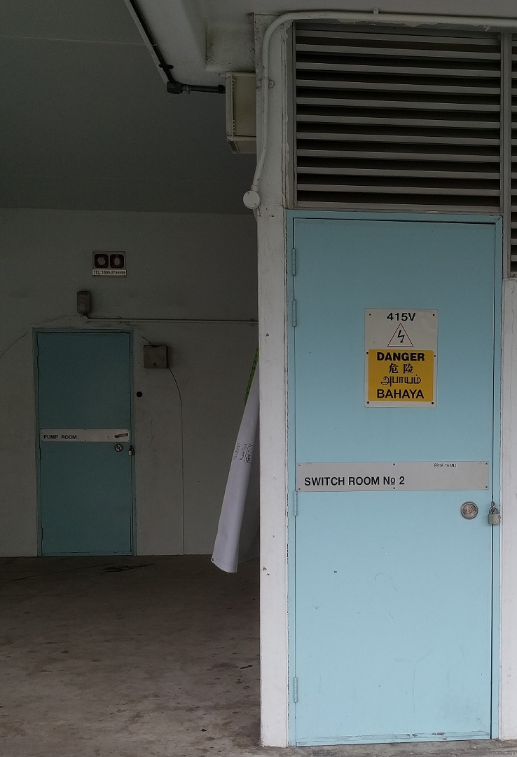
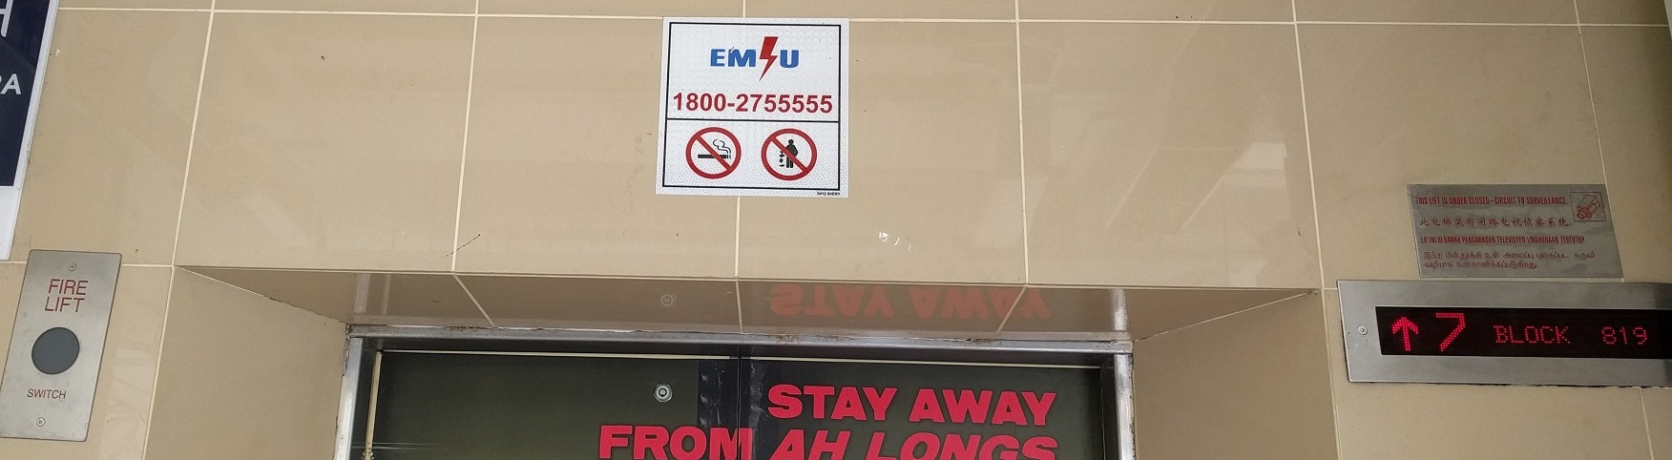
Problem 2: Inaccessible onsite breaker
Circuit breaker inside locked electrical room
Access to electrical room requires calling Essential Maintenance Service Unit (EMSU)
40 mins response time

Slide 13
Problem 3: Inconvenience of breaker trip
Breaker trips affect the work of others
Eg. Those using sewing machines and welding

Slide 14
Jurong Setup

Slide 15
10ma-rcbo-and-anti-external-cb-trip
Increased safety due to more sensitive 10mA trip rating
Isolates earth trips to this device, onsite breaker does not trip
Read instructions and test before use
Demo video: https://www.youtube.com/watch?v=h-DokWP5Kic

Slide 16
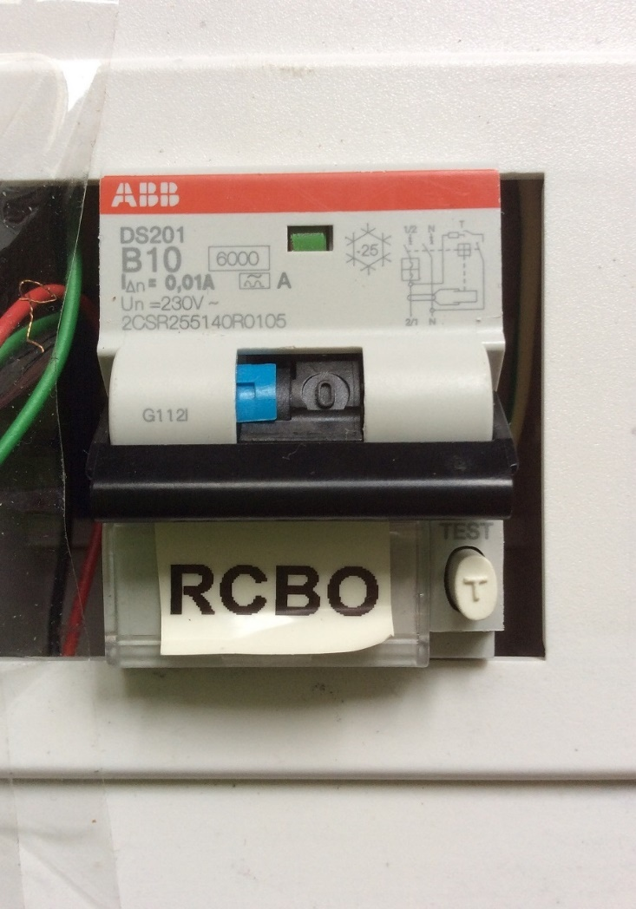
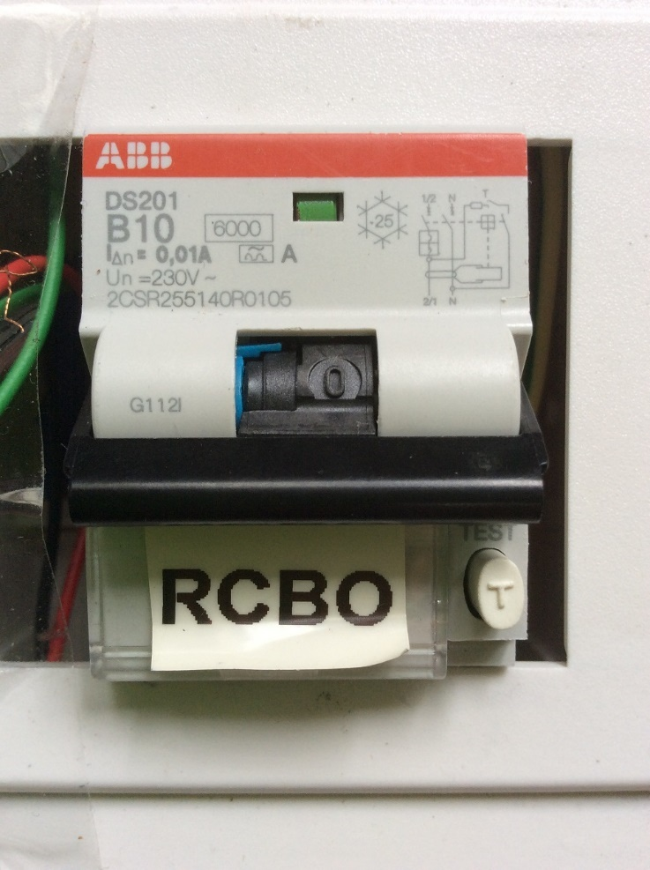
RCBO trip status
Earth trip: Switch and blue tab is down
Overload trip: Only switch is down

Slide 17
anti-trip-earth-leakage-detector
Shows blue LED on earth fault without breaker trip
Does not interrupt the work of others
Preserves lifespan of RCBO
Upstream must have 10mA RCBO
Familiarise with usage instructions beforehand
Demo video: https://www.youtube.com/watch?v=tSpie7baYFM

Slide 18
Tampines Setup

Slide 19
10ma-rcbo-mcb-and-anti-external-cb-trip
Increased safety due to more sensitive 10mA trip rating
Isolates earth trips to this device, onsite breaker does not trip
Extra MCB to increase chances of “catching” overcurrent
Read instructions and test before use

Slide 20
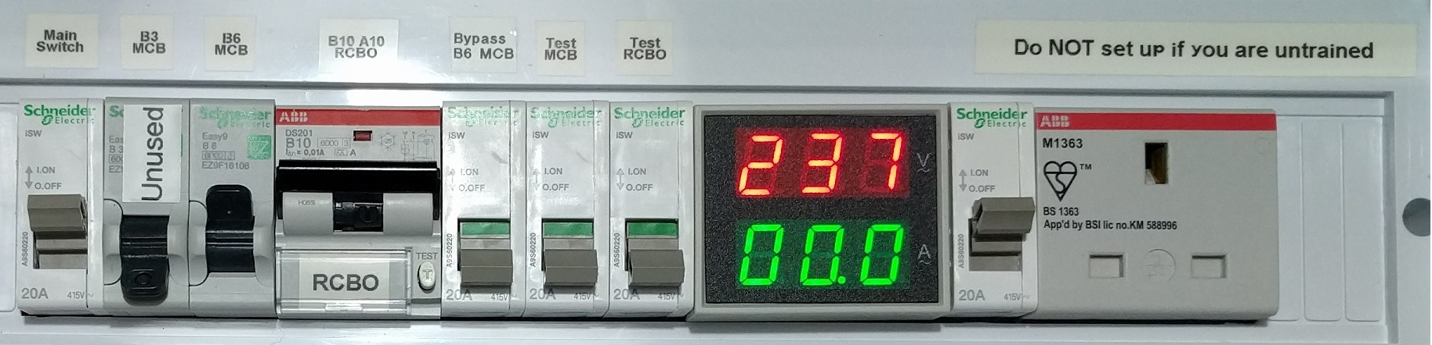
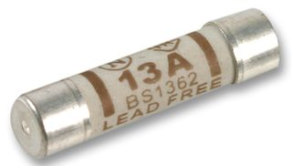
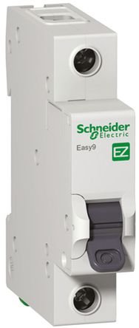
Bypass B6 MCB switch
Temporarily turn on Bypass Switch if you encounter high power appliances
0A
9A
13A
15A
13A
Fuse
No blow margin
Blow margin
Type B
6A MCB
No trip margin
May trip
Sure trip margin
How?
Blowing range of Type B: 3 – 5 times rated current, but can trip at 50% of rated current after prolonged use
6A x (3 to 5) x 50% = 9A to 15A

Slide 21
Questions?
By: Yeo Kheng Meng (yeokm1@gmail.com)
https://github.com/yeokm1/repair-kopitiam-training-and-equipment
http://yeokhengmeng.com/2016/05/repair-kopitiam-speciality-electrical-tools/

Slide 22
Setup is not fool proof!
There is an Earth-leakage via means other than the Earth wire
There is an overload in the circuit eg short circuit.
Overload Trip sensitivity of external breaker better than ours

Slide 23
General order of diagnosis
Advise participant about warranty. Then ask what is wrong, specifically if their breaker trips
RCCB trips
If “anti-trip-earth-leakage-detector” is available, use it to determine if earth fault exists. Try to locate any short to Earth wire. Dismantle appliance if needed.
No trip
Connect to main power and try to power on
No Power
Check fuse for continuity
No Power
Diagnose component by component till you find the fault or give up
Dismantle part of appliance to reach the other end of power cable and test entire cable for continuity

